Slide 1
Identifying Dominance Relationships in Written Correspondence
Nic Vogler
nvogler@berkeley.edu

Slide 2
Motivation For Work
I always spend a little more time writing emails to managers and above. Always proofread. Represent myself with an active voice, theirs with passive.
Can these and similar practices be identified and used to understand dominance relationships from compilations of email chains between two individuals?

Slide 3
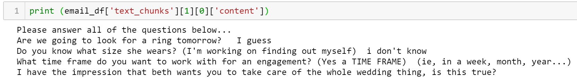
Data
Enron email dataset “Gold Standard”
276279 candid emails written without the expectation they’d become public record
After initial data prep
36027 relationships identified
Total e-mails: 192538

Slide 4
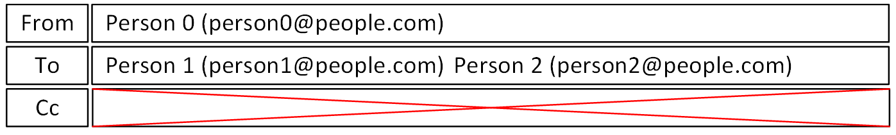
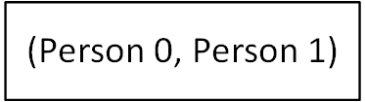

Data
“Conversation” is all e-mails sent from one individual to another individual. E-mail body and subject.

Slide 5
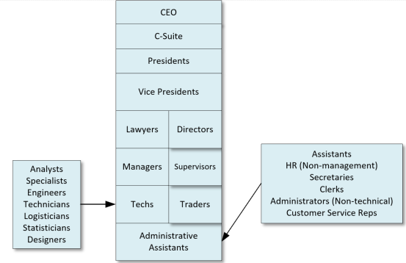
Data
Positions Split Into 8 Categories
10752 emails up
12906 emails down
12369 emails across
Mean 5.3 emails per conversation
Mean 923 characters per email

Slide 6
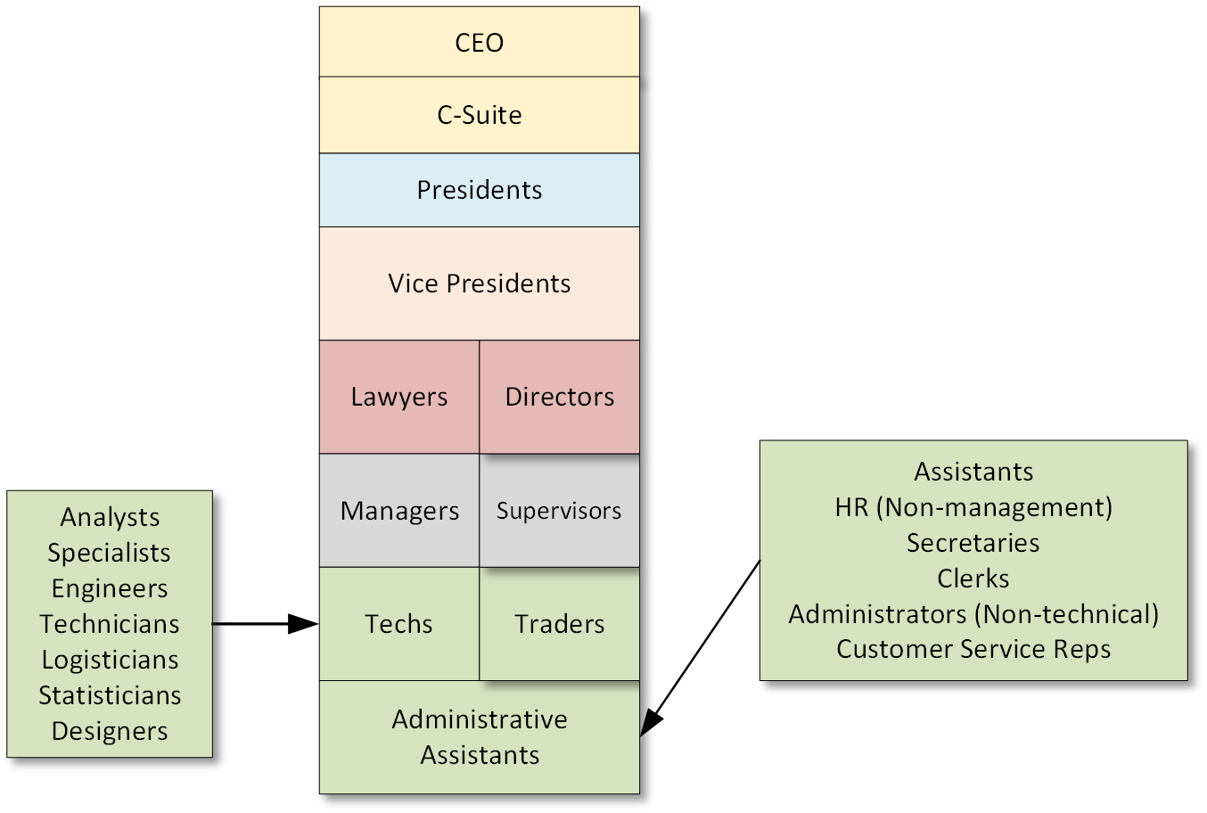
Data
Positions Split Into 6 Categories
10176 emails up
11687 emails down
14164 emails across
Rev 2

Slide 7
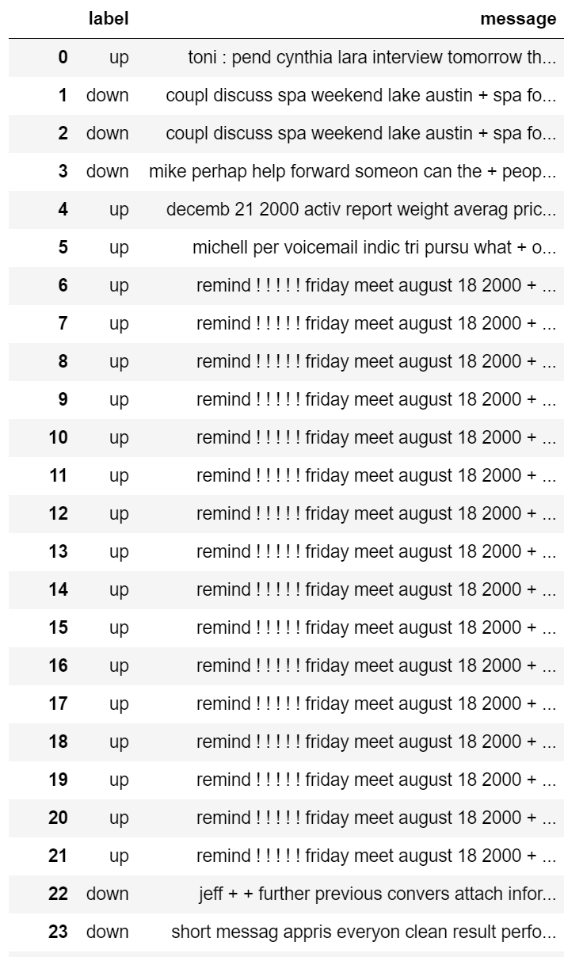
Data Challenges
Tens of thousands of duplicate emails
Identifying forwarded messages, reports, and other language not created by the sender
Creating relationships between all email addresses used by a specific employee

Slide 8


Baseline
Models | Accuracy
 | Raw Email Content | After Additional Cleansing
Unigram Naive Bayes | 55% | 63%
N-Gram Naive Bayes | 63% | 65%
Feed Forward Neural Network | 61% | 59%
Top Unigrams
Top N-grams
Notes:
Indicating upward relationship

Slide 9
Results
Model | Accuracy
LSTM | 60%
CNN | 57%
CNN-LSTM | 52%
Ultimately, my data preparation eliminated too many emails and conversations to be used with neural networks.
After removing duplicates from the set, only 11079 conversations remained.

Slide 10
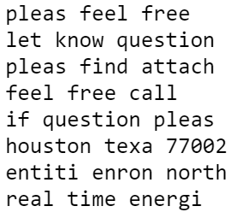
Analysis and Insights
Key phrases were found to be helpful determining the dominance relationship between two employees, although more features are needed to be confident in the outcome.
No specific words or phrases were identified to distinguish emails between upper/mid/lower level management.

Slide 11
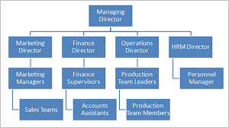
Next Steps
Add non-lexical features
Improve email pairing and conversation forming process
Construct graph of conversations between employees
Sentiment Analysis

Slide 12
Questions?

